Slide 1

Wine Cellar Design
Featuring Kessick Wine Cellars by

Slide 2
Ideal Wine Storage
Temperature/Humidity – Ideal temperatures are 55-60º F and 50-70%ideal relative humidity. Fluctuations in temperature accelerates the maturation of wine, damaging it.
Vibration – excess vibration damages wine, so a stable environment is best.
Light – Direct sunlight and UV rays, so a darker environment is ideal.

Slide 3
Aging & Cellaring wine
What wines benefit from cellaring:
© Pierre Wertheimer
If you buy several cases at a time (sometimes you have to buy as much as you can upon release as the wine is “allocated” and then will not be available for a long time), you will want to keep them in the best condition possible.
Many better wines will reach their peak after a few years, some after 10 or 20 years or more.

Slide 4
Aging & Cellaring wine
What ageing wine actually means.
© Pierre Wertheimer
It is the ability of wine to:
Develop more pleasure nuances.
In the case of red wines, show an additional melting of the tannins.
Reveal more complex and interesting flavors and aromas!
Resulting in more pleasurable and interesting wine
than upon release.

Slide 5
Aging & Cellaring wine
Do all wines benefit from aging?
© Pierre Wertheimer
No, a large proportion of wines are meant to be consumed within one or two years of the date of release.
Please note that I use the term release and not “bottling”. Some wines are release just after bottling, while other wines will age in the producer’s cellar in cask of bottles for 3 years, 5 years or more.
In fact, many European wine laws require the wine to be aged for a period of time in bottle or barrel.
Some wine critics will however taste the wine while still in barrel and score it (usually a range such as: 93-95). It is an amazing skill as most of these wines will be very harsh and the critic needs to imagine the potential of the wine a few years down the road!
However all wines will benefit from being cellared. In other words being kept in the best possible condition before being consumed.

Slide 6
Aging & Cellaring wine
When will I know that a wine is at his peak?
© Pierre Wertheimer
Ask your wine provider, he should be able to tell you when the wine is at his peak.
I say “he should”, but many wine stores are in the business of selling wine quickly. As many of their customers do not have cellars and the means to keep the wine in peak condition, they will tell you that it is best consumed right away.
In some stores, such as “big box stores” which got into the business of selling high end wines, there is nobody to ask for any advice.
Some wines will be extremely disappointing if tasted upon release. A 2008 Laffite for example will seem concentrated if tasted but with harsh tannins and will be better if open after 2016 and very possibly best if opened in 2025.
Magazines such as the Wine Spectator, the Wine Advocate can also help. They will give a window such as “Drink now through 2020” or “best from 2015 to 2025”.
When such a window is shown, some collectors will open a bottle every year to see how the wine evolves.

Slide 7
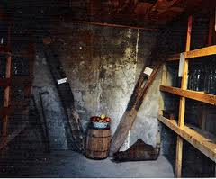
Wine Cellar Types
Passive wine cellar – below grade rooms with constant year round temperatures – similar to an old fashion “root cellar”

Slide 8
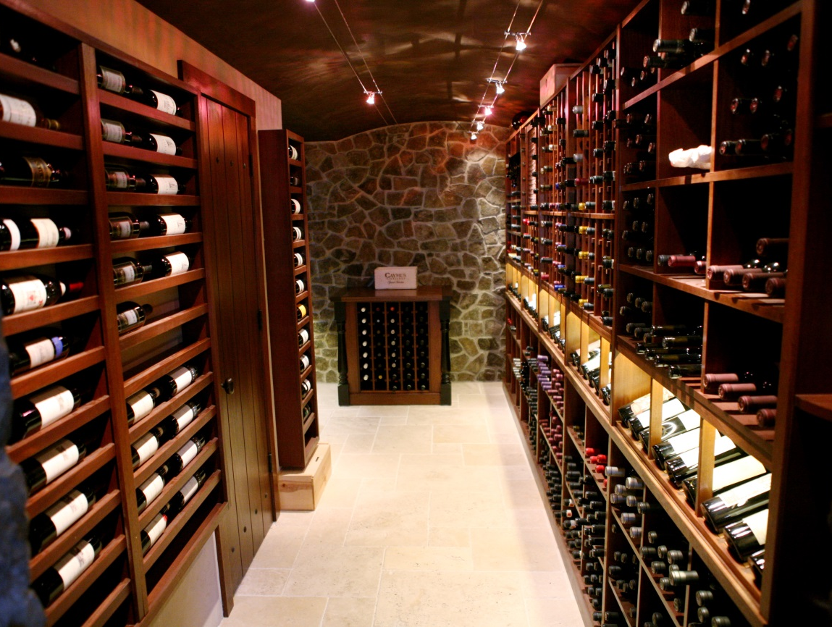
Climate Controlled Wine Cellar
Here in NC we don’t have as many basements, or root cellars, so we need to create the proper environment for proper wine storage with mechanical equipment and particular construction materials to prevent mold issues.

Slide 9
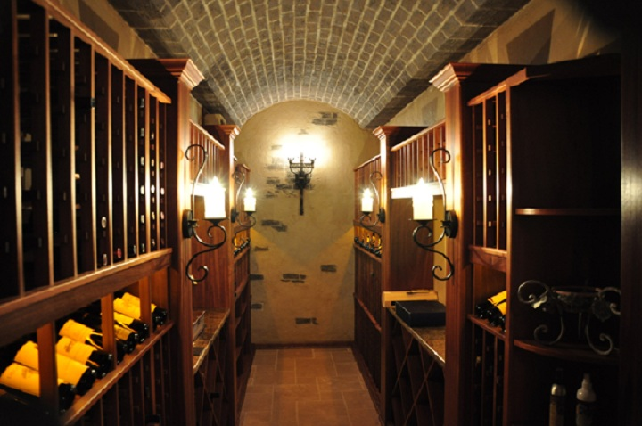

Slide 10
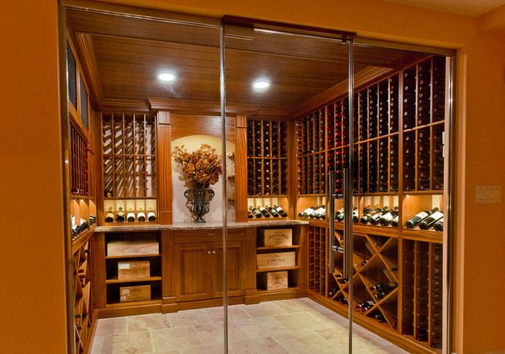

Slide 11
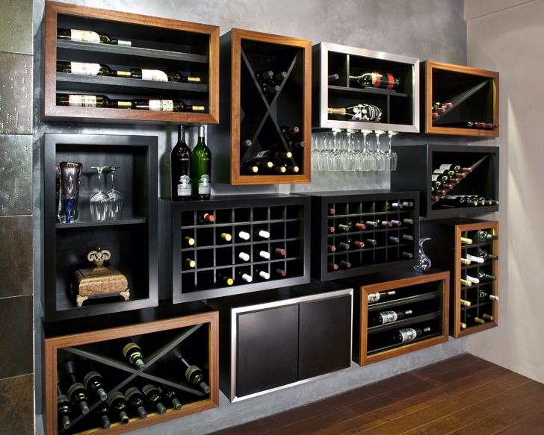

Slide 12
Room Prep Guidelines
The part of the wine cellar that you don’t see is the most critical part.
Insulation and moisture barriers are necessary to prevent mold and condensation. We recommend closed cell spray foam insulation.
Exterior (insulated) door with weather-stripping and threshold.
Moisture rated sheetrock, or Dens Armour board for wall.

Slide 13
Interior Finishes
Interior finishes can be done with many things, but exterior grade products seem to work best. Brick, stone, cedar, cypress, etc. work great for walls & ceilings. Paint over moisture rated sheetrock is okay.
Cork, stone, slate, tile, brick pavers, etc. for the floor.
LED lighting is ideal. Can lights are not recommended.

Slide 14
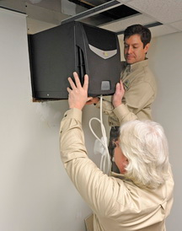
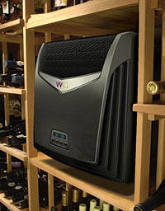
Climate Control Options
Through the wall units – similar to window air conditioner. Cheapest and easiest to install. But is noisy and has limited range of cooling to maintain 55º F.

Slide 15
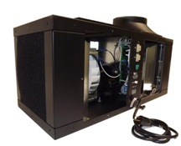
Self Contained Ducted System
A ducted self contained systems is located within 25’ of the cellar, but removes the noise and vibration from the room. Can be located in a crawl space and does not need an HVAC contractor to install it.
http://wineguardian.com/wine-cellar-environmental-systems/ducted/

Slide 16
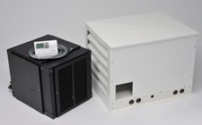
Split System Climate Control
Requires HVAC contractor to install and is the most expensive option. It is visible in the room and condensation removal can be difficult.
A ducted split system provides superb air distribution and temperature control for optimal conditioning of your valuable wine collection. The extremely quiet and virtually vibration-free system offers maximum flexibility in system location and cellar designs. This makes it ideal for cellars that have no space to install a self-contained system, for applications where condenser air is difficult to exhaust, and for longer duct runs.

Slide 17
Wine Racking Options
Unassembled Kits – the pieces and parts are shipped to you to assemble on site. Typically, they are Redwood or Cedar and take many man-hours to assemble. They are less expensive for the materials.
Kessick Wine racking is fully assembled as a frameless cabinet and made of Sapele Mahogany, White Oak, or Walnut. The bottle spacing is made for 750s up to champagne bottle for individual columns, and can accommodate magnums in many different designs.

Slide 18
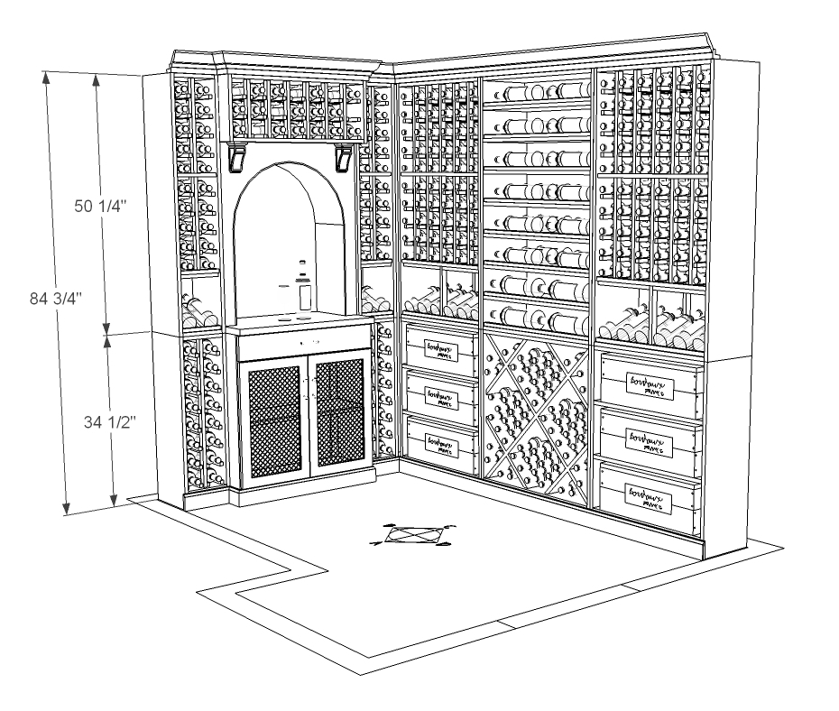

Slide 19
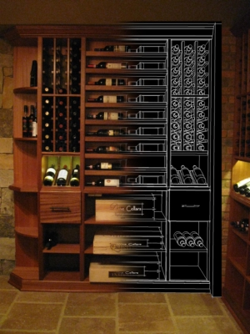

Slide 20
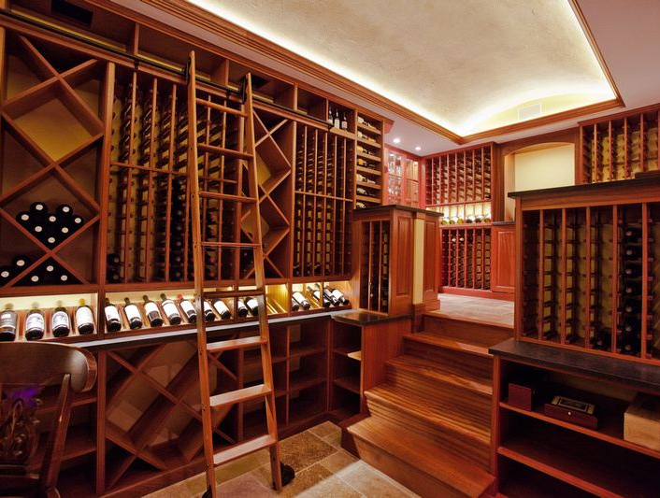
Custom Designed Wine Cellars
Distinctive Remodeling can help you design your ideal wine cellar, no matter what your primary goals are: utilitarian, aesthetic wow!, or a combination of both.

Slide 21
Wine Cellar Management
Cellar Tracker – a great way to manage your wine cellar. Keep track of all of your wines, when they should be consumed, what the value of your collection is, barcode support, track pending deliveries, wish lists, shopping lists, label images, tasting notes, etc.

Slide 22

Thank you for coming!
www.DistinctiveRemodeling.com

